Slide 1

Delegates
.net

Slide 2
A delegate is a data type that represents a reference to a method with a defined parameter and return type. A delegate can be associated with an instance of any method with the same signature and return type. The method can be invoked through the delegate instance.
https://docs.microsoft.com/en-us/dotnet/csharp/programming-guide/delegates/

Slide 3
Binding - Overview https://docs.microsoft.com/en-us/dotnet/desktop-wpf/data/data-binding-overview#what-is-data-binding https://docs.microsoft.com/en-us/dotnet/csharp/delegates-overview https://en.wikipedia.org/wiki/Late_binding#Late_binding_in_.NET
Binding - This process establishes a connection between an app UI and the data it displays. When the data changes its value, the elements (in memory) bound to the data reflect the changes automatically.
Early Binding (AKA Static Binding, Static Dispatch, or Compile-Time Binding) – The compiler (or linker) directly associates a stack memory address to the function call. It replaces the call with a machine language instruction that tells the mainframe to leap to the address of the function.
Late Binding (AKA Dynamic Binding, Dynamic Dispatch, Dynamic Linkage, or Run-Time Binding) – When an algorithm is created that uses a caller-supplied method that implements part of the algorithm (like function pointers). In .NET, late binding refers to overriding a virtual method. The compiler builds virtual tables for every virtual or interface method call which is used at run-time to determine the implementation to execute.
Delegates use late binding in .NET.

Slide 4

Delegate – Overview https://docs.microsoft.com/en-us/dotnet/csharp/programming-guide/delegates/
Delegates enable developers to learn one concept and use that same concept across many different software problems.
Delegates are used to pass methods as arguments to other methods. This ability to refer to a method as a parameter makes delegates ideal for defining callback methods.
A delegate is a type that represents references to methods with a defined parameter list and return type. When you instantiate a delegate, you can associate its instance with any method with a compatible signature and return type. You can invoke (call) the method through the delegate instance.
This example declares a delegate Del that can encapsulate any method that takes a string as an argument and returns void.
Delegates are type safe, and secure. Only methods or structs that that are accessible and match the delegate type and return type can be assigned to the delegate.

Slide 5
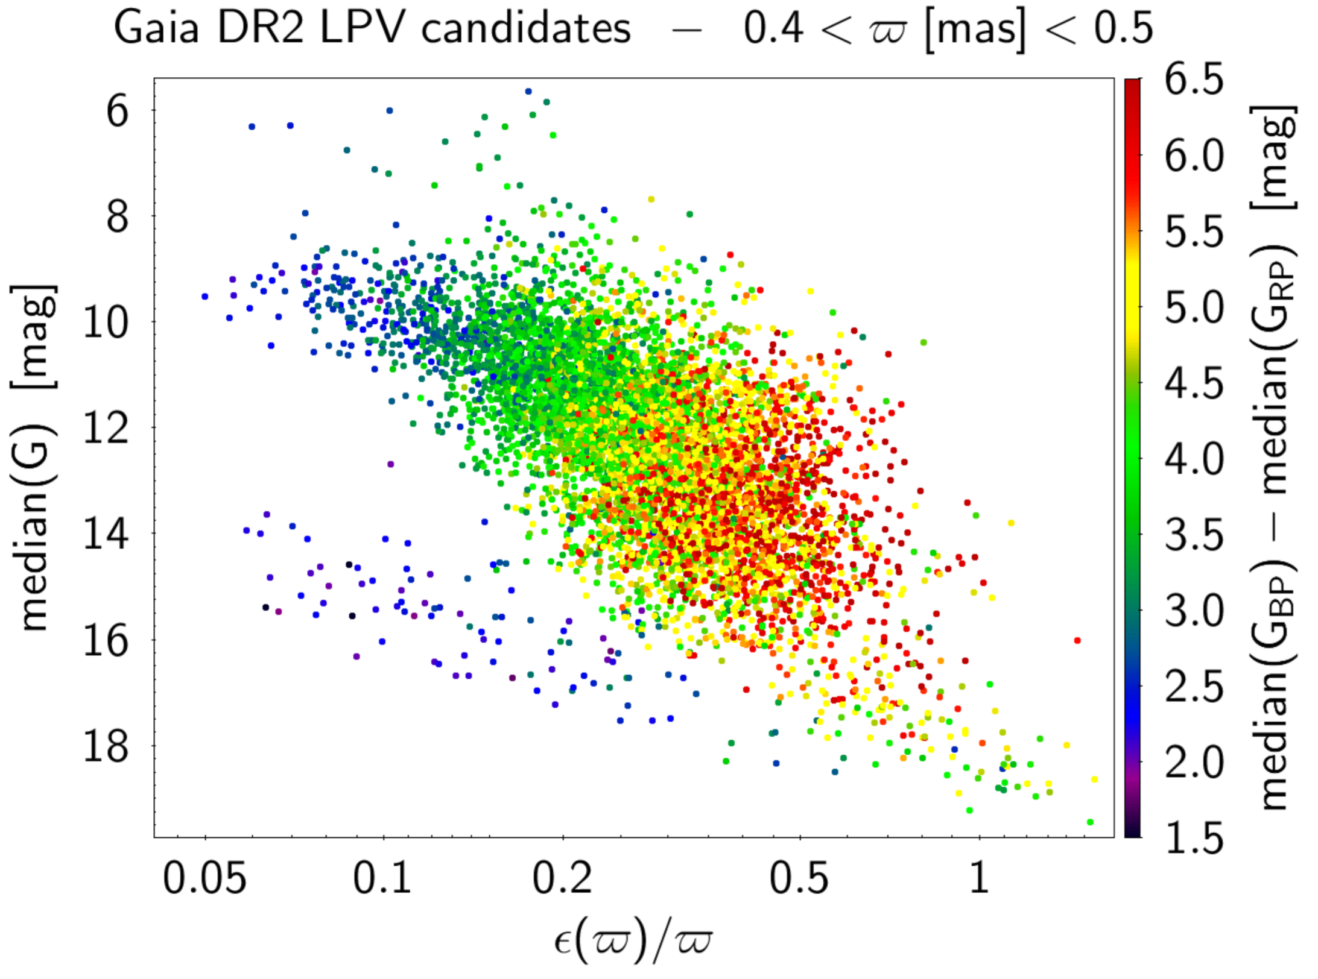
Delegate – Usage Example
Consider sorting a list of stars in an astronomy application. You may choose to sort those stars by their distance from the earth, or the magnitude of the star, or their perceived brightness.
In all those cases, the Sort() method does essentially the same thing. It arranges the items in the list based on some comparison. The code that compares two stars is different for each of the sort orderings.

Slide 6
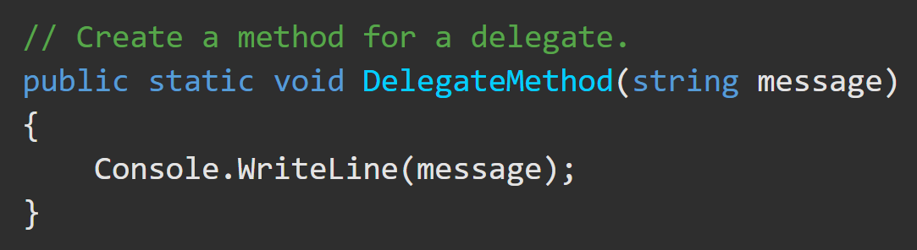
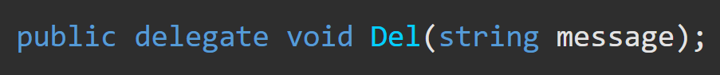
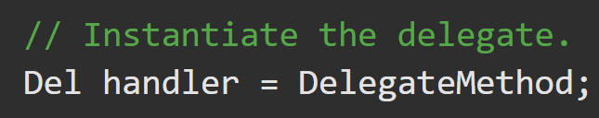
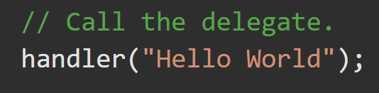
Delegate – Step by Step https://docs.microsoft.com/en-us/dotnet/csharp/programming-guide/delegates/using-delegates
1. Create a method to assign to a delegate.
2. Create a delegate type (Del) with the same return type and argument. This must be outside of a method.
3. Instantiate a delegate type variable and assign to it the chosen function (DelegateMethod()). The delegate variable is what gets passed to a function.
4. Invoke the delegate variable. If the original method (DelegateMethod()) returns a value, it will be returned through the delegate variable (handler).

Slide 7
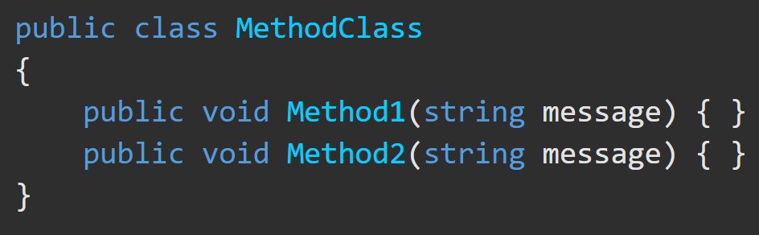
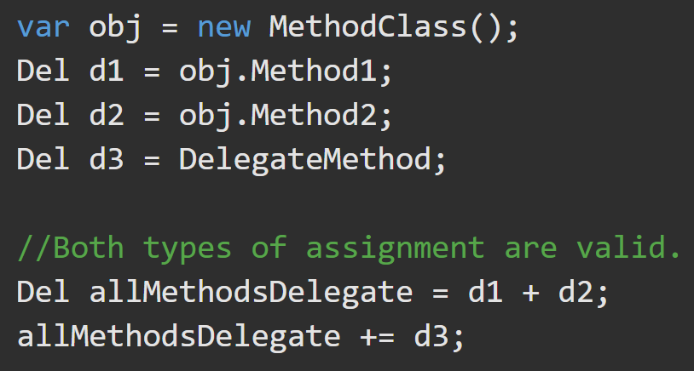
Delegate – Multicasting https://docs.microsoft.com/en-us/dotnet/csharp/programming-guide/delegates/how-to-combine-delegates-multicast-delegates
A delegate can call more than one method when invoked. This is referred to as multicasting. To add an extra method to the delegate’s (ordered) method invocation list use the addition assignment operators ('+' or '+=‘).
allMethodsDelegate is a delegate type object that points to other delegate type objects that point to a delegate variable that refers to a function or invocation list. Arguments are passed from delegate obj to delegate obj to function.

Slide 8
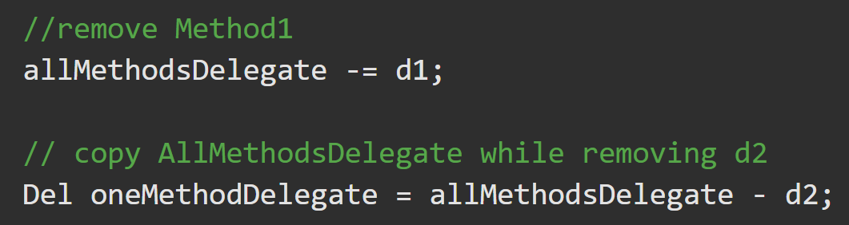
Delegate – Multicasting https://docs.microsoft.com/en-us/dotnet/csharp/programming-guide/delegates/how-to-combine-delegates-multicast
Reference arguments are passed sequentially to each method in turn. Any changes by one method are visible to the next method.
If any method in the method invocation list throws an uncaught exception, execution stops. The exception is passed to the caller of the delegate.
If the delegate has a return value and/or out parameters, it returns the return value and/or out parameters of only the final method invoked.
To remove a method from the invocation list, use the subtraction or subtraction assignment operators (- or -=).

Slide 9
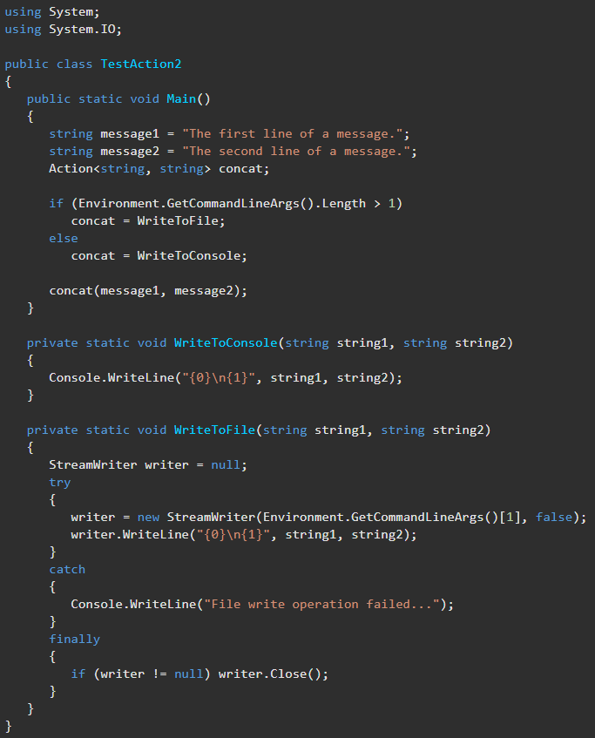
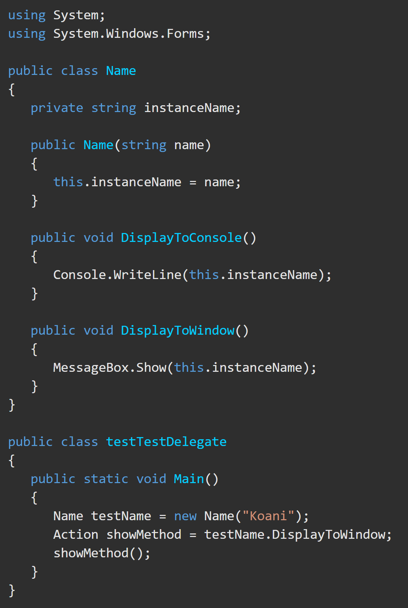
Action and Action<T> Delegate https://learn.microsoft.com/en-us/dotnet/api/system.action?view=net-8.0
You can use a .NET Action delegate without declaring a custom delegate.
Action Delegates are no different than custom delegates and have simpler syntax. They always return void.
The encapsulated method must correspond to the parameter list defined by the Action delegate and return void.

Slide 10
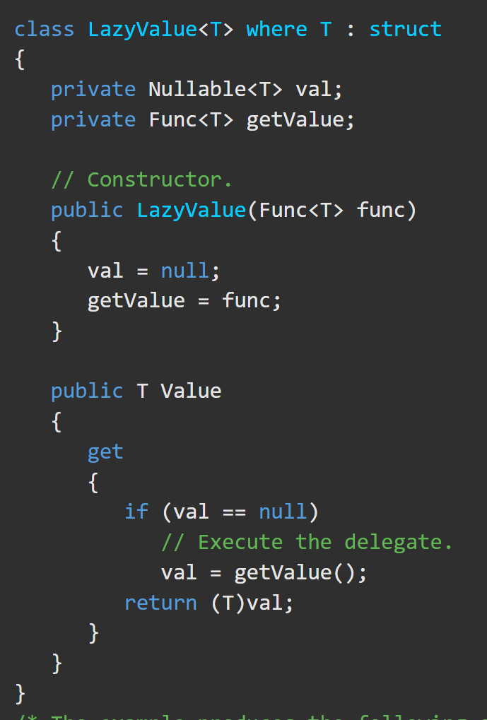
Func<TResult> Delegate https://docs.microsoft.com/en-us/dotnet/api/system.func-1?view=net-8.0
Use Func<TResult> delegate to represent a method that can be passed as a parameter without explicitly declaring a custom delegate. The encapsulated method must correspond to the method signature that is defined by this delegate.
TResult is the type of the return value of the method that the Func<TResult> delegate encapsulates. This type parameter is covariant, meaning you can use your specified type or a more derived type.
Ex. Func<TResult> means that the encapsulated method must have no parameters and must return a value.
Func<arg1,TResult>, Func<arg1, arg2, TResult>, etc, are variations that have arguments along with the return type.

Slide 11
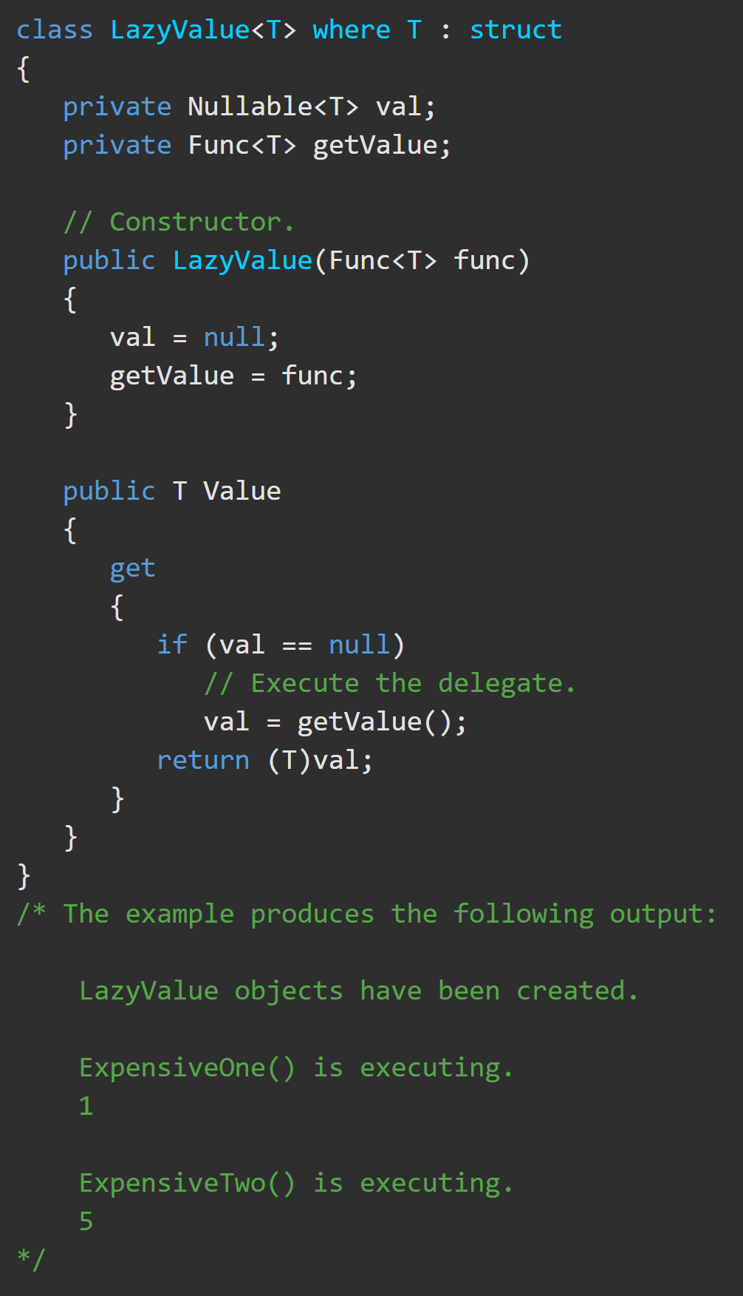
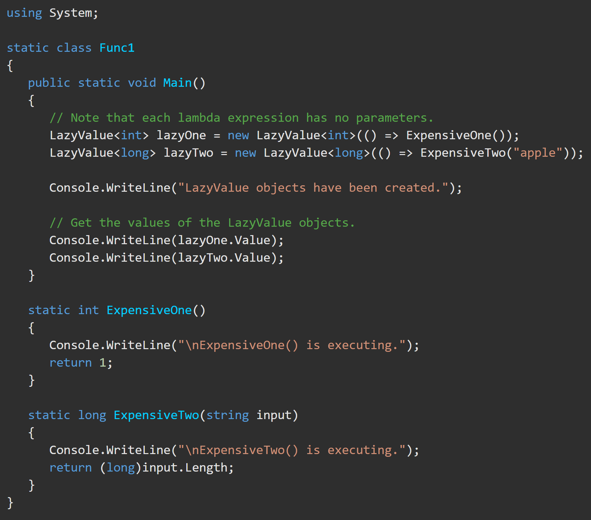
Func<TResult> Delegate https://docs.microsoft.com/en-us/dotnet/api/system.func-1?view=net-5.0

Slide 12
Events – Overview https://docs.microsoft.com/en-us/dotnet/csharp/programming-guide/events/
Events enable a class or object to notify other classes or objects when something occurs. The class that sends (raises) the event is called the publisher and the classes that receive (handle) the event are called subscribers.
Events are a special kind of multicast delegate that can only be invoked from within the class or struct where they are declared (the “publisher” class). If other classes or structs subscribe to the event, their event handler methods will be called when the publisher class raises the event.
To register for, then trigger an event:
the recipient creates a method designed to handle the event, then
creates a delegate for that method and
passes the delegate to the event source.
The source calls the delegate when the event occurs.
The delegate then calls the event handling method on the recipient, delivering the event data. The delegate type for a given event is defined by the event source.

Slide 13
Events – Properties https://docs.microsoft.com/en-us/dotnet/csharp/programming-guide/events/
publisher – determines when an event is raised; the subscribers determine what action is taken in response to the event.
event – can have multiple subscribers. A subscriber can handle multiple events from multiple publishers.
Events are typically used to signal user actions such as button clicks or menu selections in graphical user interfaces.
When an event has multiple subscribers, the event handlers are invoked synchronously.
In the .NET class library, events are based on the EventHandler delegate and the EventArgs base class.

Slide 14
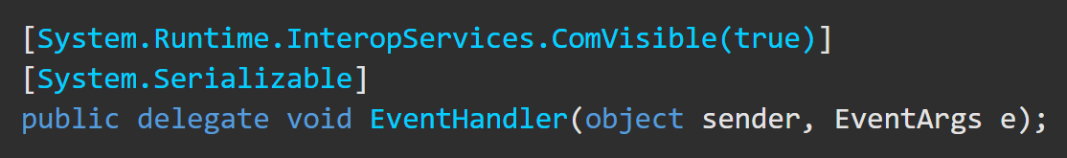
EventHandler Pattern https://docs.microsoft.com/en-us/dotnet/api/system.eventhandler?view=net-5.0 https://docs.microsoft.com/en-us/dotnet/csharp/programming-guide/events/how-to-publish-events-that-conform-to-net-framework-guidelines
All events in the .NET class library are based on the EventHandler delegate. The standard signature of an eventHandler delegate defines a method that returns void. This method's first parameter is of type Object and refers to the instance that raises the event. Its second parameter is derived from type EventArgs and holds the event data.
All events should be based on the .NET pattern by using EventHandler.

Slide 15
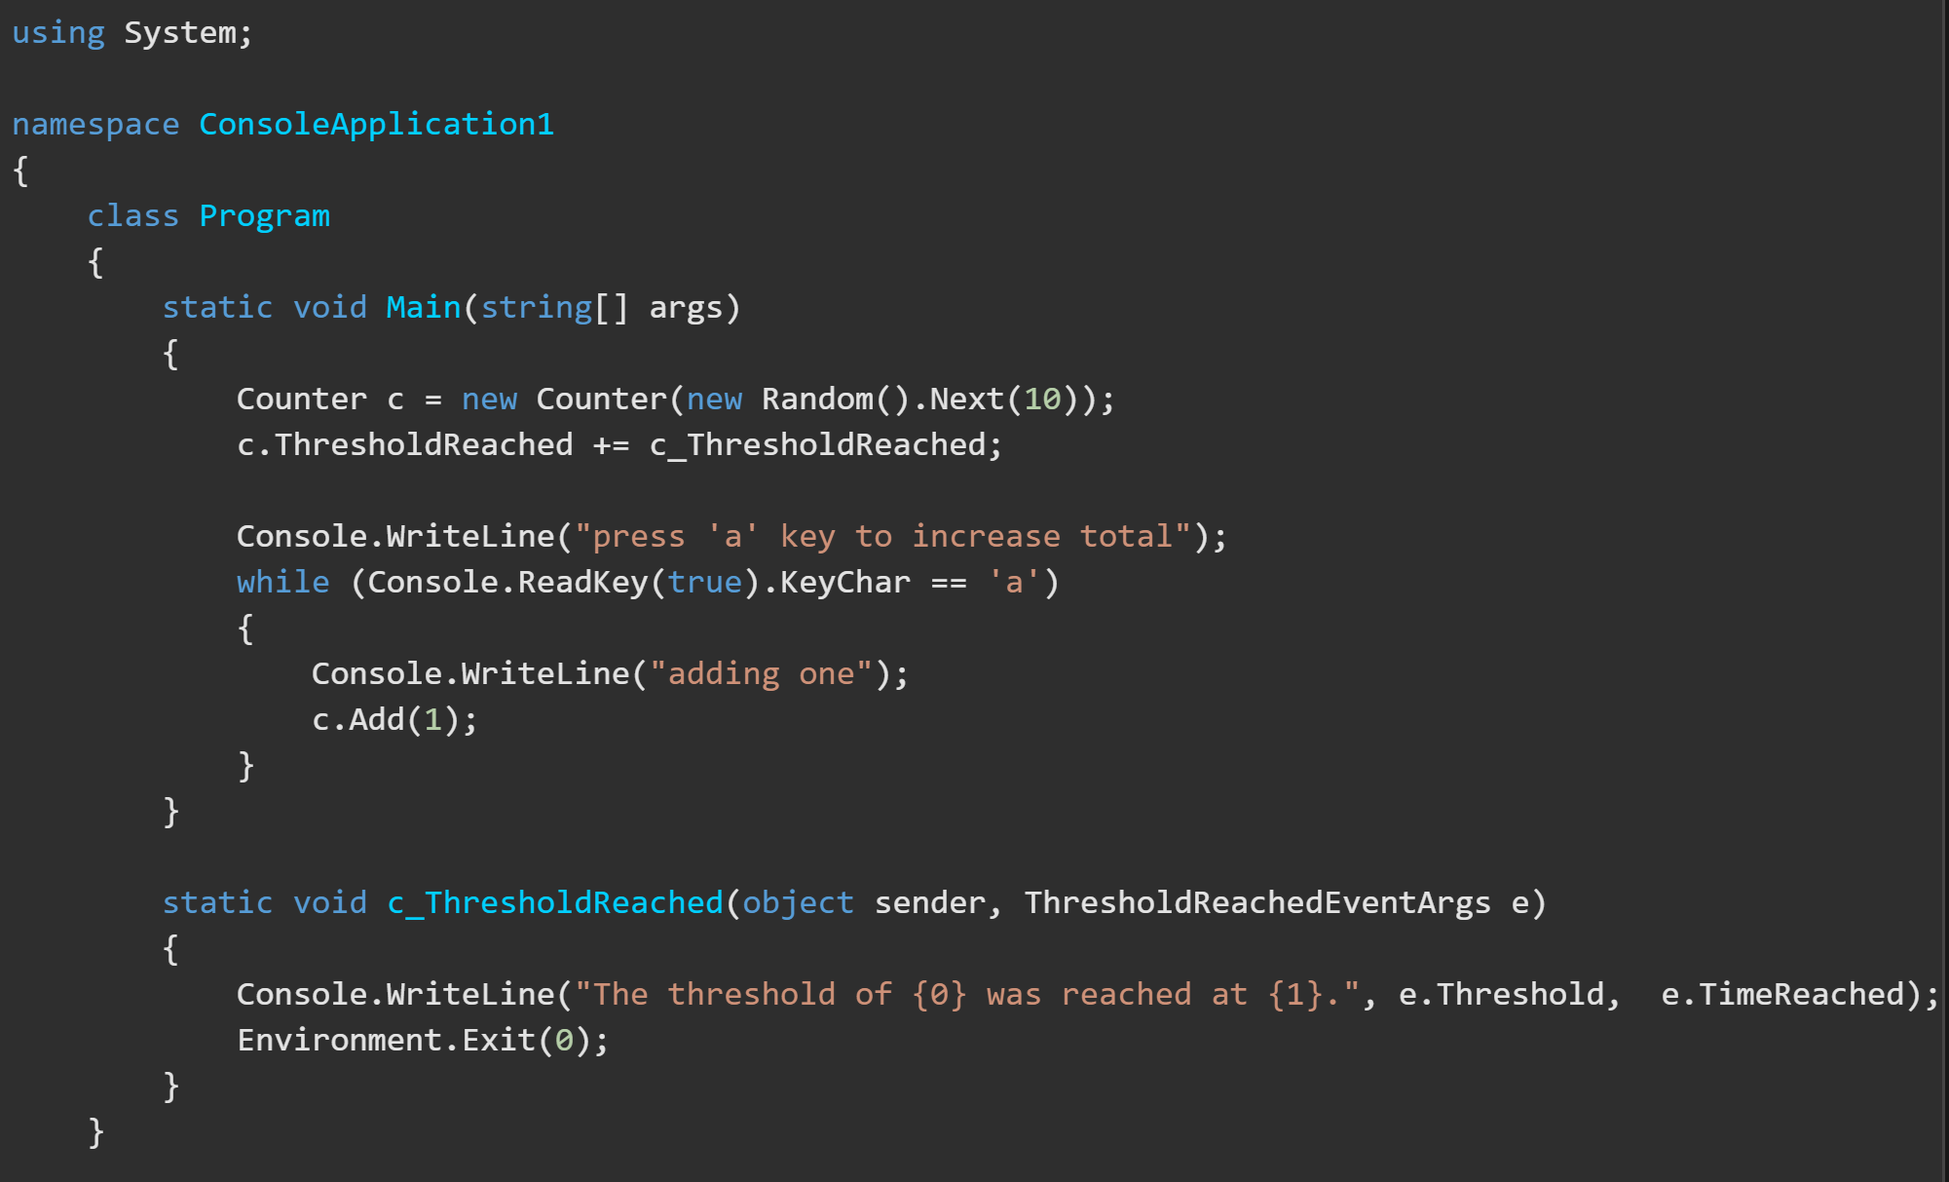
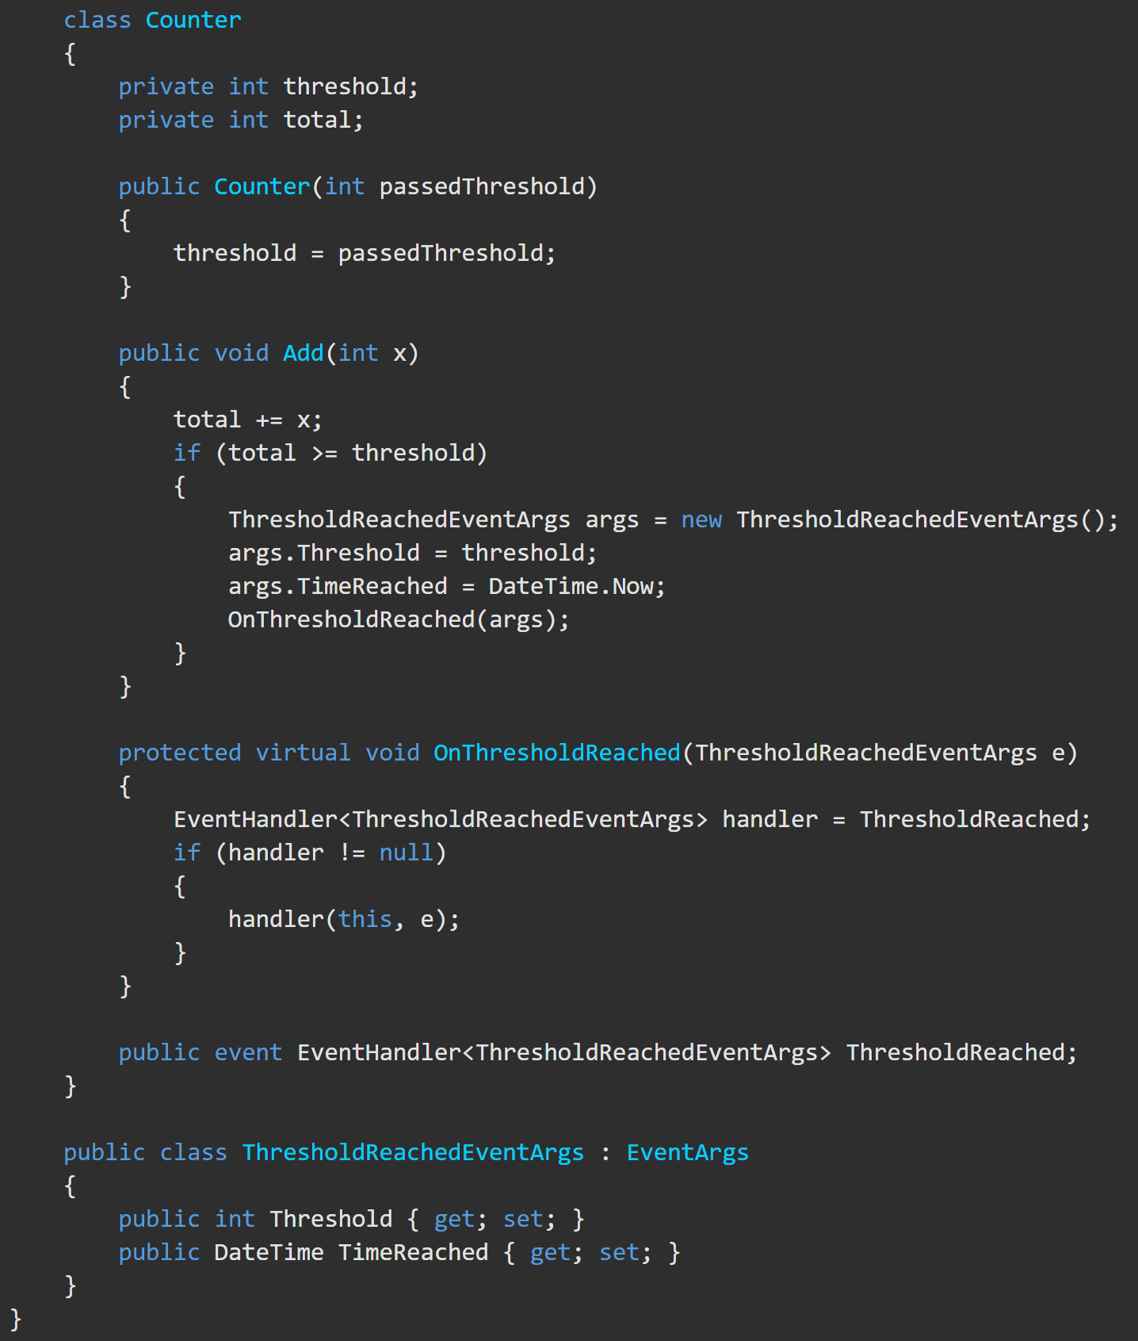
Events – Publishing Based on the EventHandler Pattern https://learn.microsoft.com/en-us/dotnet/api/system.eventhandler?view=net-8.0#examples
This example shows an event named ‘ThresholdReached’ that is associated with an ‘EventHandler’ delegate. The method assigned to the EventHandler delegate is called in the ‘OnThresholdReached’ method.
A delegate connects an event with its handler. To raise an event, two elements are needed:
A delegate identifying the method that provides the response to the event.
(Optional) A class that holds the event data, if provided.
//this is passed on instantiation
//this starts at 0
//constructor
//instantiate a class Counter instance
//add one more to the running total
//add the method to the ThreshholdReached EventHandler of ‘c’
//create a EventArgs Object
Click to view this example online.
// add the threshold and current time // to the object then call the method
//wait for ‘a’ to be pressed
//call the Add method of ‘c’ with 1 as the argument.
// check to make sure handler(ThresholdReached) was assigned at the beginning, then call handler(ThresholdReached)(c_ThreshholdReached().
// This class has inherits .NET’s EventArgs class and adds 2 more properties

Slide 16
Events – Publishing Based on the EventHandler Pattern https://docs.microsoft.com/en-us/dotnet/api/system.eventhandler?view=net-5.0#examples https://docs.microsoft.com/en-us/dotnet/standard/events/?view=net-5.0
The EventHandler delegate is a predefined delegate that specifically represents an event handler method for an event that does not generate data. If your event does generate data, you must use the generic EventHandler<TEventArgs> delegate class.
To associate the event with the method that will handle the event, add an instance of the eventHandler delegate to the event. The event handler is called whenever the event occurs, unless you remove the delegate.
The delegate model follows the observer design pattern, which enables a subscriber to register with and receive notifications from a provider. An event sender pushes a notification that an event has happened. An event receiver receives that notification and defines a response to it.

Slide 17
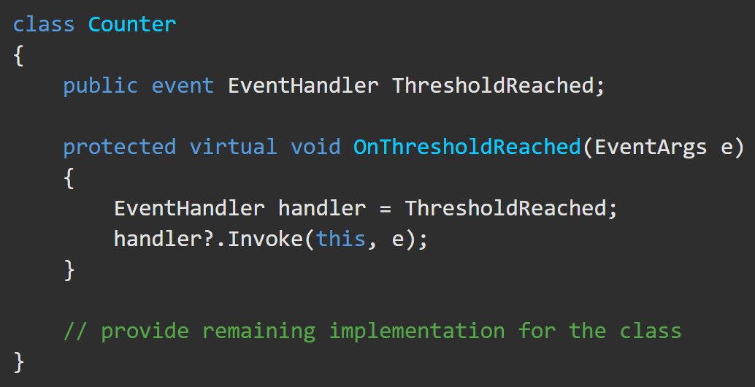
Events – Publishing Based on the EventHandler Pattern https://docs.microsoft.com/en-us/dotnet/api/system.eventhandler?view=net-5.0#examples https://docs.microsoft.com/en-us/dotnet/standard/events/?view=net-5.0
The object that raises the event is called the event sender. The event is typically a member (method) of the event sender. To define an event, use the event keyword in the signature of your event class and specify the type of delegate for the event.
Add a method that is marked as protected and virtual, conventionally named ‘On[EventName]()’ (‘OnDataReceived()’). The method should take one parameter of object type EventArgs (or a derived type).
Derived classes can override this method. A derived class should always call the ‘On[EventName]()’ method of the base class to ensure that registered delegates receive the event.

Slide 18
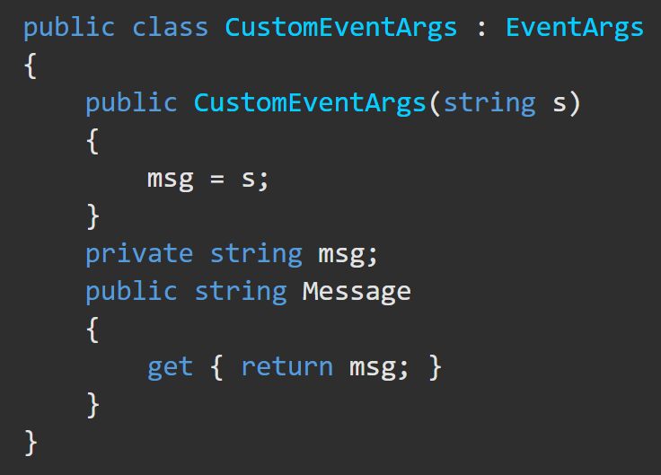

Events – Publishing Based on the EventHandler Pattern – Step by Step https://docs.microsoft.com/en-us/dotnet/csharp/programming-guide/events/how-to-publish-events-that-conform-to-net-framework-guidelines
1. (If not sending custom data with your event, go to 3a) Declare the class for your custom data at a scope that is visible to both your publisher and subscriber classes. Then, add the required members to hold your custom event data. ➔ ➔ ➔ ➔ ➔ ➔ ➔
2. (Skip if using generic version of EventHandler<TEventArgs>). Declare a delegate in your publishing class. Use a name ending with EventHandler. The second parameter specifies your custom EventArgs class type.

Slide 19



Events – Publishing Based on the EventHandler Pattern – Step by Step https://docs.microsoft.com/en-us/dotnet/csharp/programming-guide/events/how-to-publish-events-that-conform-to-net-framework-guidelines
3. Declare the event in your publishing class by using one of the following steps.
a. If you have no custom EventArgs class, your Event type will be the non-generic EventHandler delegate. You do not have to declare the delegate because it is already declared in the System namespace. Add the following code to your publisher class.
b. If you are using the non-generic version of EventHandler AND have a custom class derived from EventArgs, declare your event inside your publishing class and use your delegate from step 2 as the type.
c. If you are using the generic version, you do not need a custom delegate. Instead, in your publishing class, specify your event type as EventHandler<CustomEventArgs>, substituting the name of your own class between the angle brackets.

Slide 20
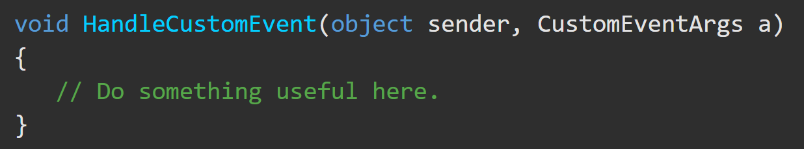

Events – Subscribing https://docs.microsoft.com/en-us/dotnet/csharp/programming-guide/events/how-to-subscribe-to-and-unsubscribe-from-events#to-subscribe-to-events-programmatically
1. Define an event handler method whose signature matches the delegate signature for the event.
2. Use the addition assignment operator (+=) to attach event handlers to the event. In the following example, assume that a class object named publisher has an event named RaiseCustomEvent.

Slide 21

Events – Unsubscribing / Garbage Collection https://docs.microsoft.com/en-us/dotnet/csharp/programming-guide/events/how-to-subscribe-to-and-unsubscribe-from-events#unsubscribing
To prevent your event handler from being invoked when the event is raised, unsubscribe from the event. In order to prevent resource leaks, you should unsubscribe from events before you dispose of a subscriber object. Until you unsubscribe from an event, the multicast delegate that underlies the event in the publishing object has a reference to the delegate that encapsulates the subscriber's event handler. As long as the publishing object holds that reference, garbage collection will not delete your subscriber object.
When all subscribers have unsubscribed from an event, the event instance in the publisher class is set to null.

Slide 22
EventHandler vs Delegate https://learn.microsoft.com/en-us/dotnet/csharp/distinguish-delegates-events (tutorial)https://learn.microsoft.com/en-us/dotnet/csharp/delegates-overview
Delegate | Event
Delegates and Events both call methods that are only known at run time.
They both support singlecast and multicast scenarios.
They have the same syntax for adding and removing handlers.
Raising an event and calling a delegate use the same syntax.
They both support the .Invoke() method syntax for use with the ?. operator.
If your code depends on the subscriber’s results, use delegates.
 | If your code can complete all its work without calling any subscribers, use events.
Delegates are often passed as parameters and stored as private class members, if at all.
Individual classes can invoke delegates. | Only the class containing the event can invoke the event.
 | Events are typically public class members.

Slide 23
EventHandler vs Delegate https://learn.microsoft.com/en-us/dotnet/csharp/distinguish-delegates-events (tutorial)https://learn.microsoft.com/en-us/dotnet/csharp/delegates-overview
The above considerations are not hard and fast rules. Instead, they represent guidance that can help you decide which choice is best for your particular usage. Because they are similar, you can even prototype both, and consider which would be more natural to work with.

